Slide 1


SEND (Special Educational Needs and Disabilities) Information Report
What we offer to the children at Sawley Infant and Nursery School
We all
at Sawley Infant and Nursery School

Slide 2







What do we offer at Sawley Infant and Nursery School?
Contact Us
Meet the team
What is the SEND information report about?
How do I know how well my child is doing?
How do we work with other agencies?
What do we offer to pupils with SEND?
What do all those abbreviations mean?
How do we work in partnership with parents and carers?

Slide 3

Our SEND (Special Educational Needs & Disability) Information Report offers information for parents, in a single place, which helps them to understand what services they and their family can expect from our school and Derbyshire County Council.
The changes in the Children and Families Bill affect the way children with special educational needs (SEN) are supported in schools. The new approach commenced in September 2014 and places pupils at the centre of planning. The key principles of the new legislation are:
Young people and their families should be involved in discussions about the support they need, so they can share their knowledge and feed back to the school on the young person’s progress.
Education, health and care plans (EHC) will replace statements of special educational needs. New assessments for additional educational needs will follow the EHC guidelines from September 2014.
School Action and School Action Plus will be replaced by a single school-based category for children who need extra specialist support.
We are an inclusive school and we follow the guidelines from the Special educational needs and disability code of practice: 0 to 25 years (June 2014). We ensure that all of our children are included in all aspects of learning and school life from Nursery to Year Two.
Our school’s definition of SEND is “Any child who receives any support which is additional to or different from everyday practice and/or receives support from outside agencies”. The decision to identify a child as having SEND is made by the school after consultation with parents/ carers and is based on each child’s individual needs.
What is the SEND information report about?

Slide 4

Do children with SEND come to Sawley Infant and Nursery School?
What kinds of SEND does the school make provision for?
What do you do once additional needs have been identified?
What do I do if I think my child has SEND or requires additional support, a referral or diagnosis?
How will I know if my child is receiving SEND support and whether it is helping?
How are children with SEND supported in school?
How does the school know if my child has SEND?
How do you help school staff to support children with SEND?
How does the school support emotional and social development?
What do we offer to pupils with SEND?

Slide 5
What kinds of SEND does the school make provision for?
Sawley Infant and Nursery School are part of ONE Academy Trust. We are based on the same site as Sawley Junior School and cater for children aged 3 – 7 year olds.
Our school currently provides additional and/or different provision for a range of needs, including:
Communication and Interaction
Cognition and Learning
Social, Emotional and Mental Health
Sensory and/ or Physical
e.g. Attachment disorder, ADHD, Anxiety
e.g. Visual / Hearing impairment, mobility difficulties
e.g. Speech and Language, ASD
e.g. Dyslexia, GLD

Slide 6

Do children with SEND (Special Educational Needs and Disabilities) come to Sawley Infant and Nursery School?
We are committed to enabling all children to ‘Sparkle and Shine’.
We have an SEND policy in place to support any children who require additional support.
We also have an Intimate Care policy for any children with specific needs which is available upon request.
Admissions

Slide 7
What arrangements are there for the admission of students with disabilities?
The arrangements for the admission of pupils with Special Needs or disabilities to gain admission as pupils to Sawley Infant School fall within our duties under the Equality Act 2010 and are the same as those applied to all pupils.
The Disability Discrimination Act 1995 defines a disabled person as one who has a physical or mental impairment which has a substantial and long-term adverse effect on a persons ability to carry out normal day-to-day activities.
Most children with Special Needs will not be disabled within the meaning of the Act. The admission of pupils with disabilities is considered in the first instance in the same way as non-disabled pupils. Further considerations are made in the light of need and accessibility. In the case of a pupil with an Education, Health and Care Plan (EHCP), the Local Authority will consult with the school to see whether the school is able to meet the child’s individual needs. If the school is able to meet the child’s needs, then a plan to support the child starting at Sawley Infant School is agreed. For pupils without an EHCP, children with SEND are afforded the same rights as other children in terms of their admission to our school. Pupils are admitted without reference to aptitude or ability.
We are always pleased to meet new parents in person and show them around. Please telephone the school to make arrangements, or email or call in – ask for Mrs Morley or Mrs Cross, our SENCOs, who will be happy to meet with you in the first instance so that we can do everything reasonably possible to meet your child's specific needs. You will always be welcomed! We can also advise you on the application process if needed.
Accessibility

Slide 8
The Facilities that we provide to help disabled pupils to access the school:
Generally, the school is very spacious and is easily accessible for children who may need additional equipment. However, to increase accessibility a number of adaptations have been made to the school environment. These include:
Raising of the floor levels entering the school into a number of classrooms to enable easier access for wheelchairs.
The development of an accessible toilet including a change bed and hoist.
Outside, children have access to a large playground and a large school field. All of which can be accessed by all children. There are opportunities for outdoor learning for all children and raised planters for children to grow plants and flowers.
A trim trail is installed and is designed to increase accessibility for all children.
How accessible is the school environment?
Treatment

Slide 9
The steps we have taken to prevent disabled pupils from being treated less favourably than other pupils:
Sawley Infant School strives to ensure that the culture and ethos of the school are such that, whatever the abilities and needs of members of the school community, everyone is equally valued and treats one another with respect. In line with the Equalities Act, 2010, Sawley Infant school aims to accommodate pupils with disabilities. In consultation with a child's parents/carers, individual needs are planned for to prevent any pupils being treated less favourably, than other pupils. We will take all steps possible, to provide an effective educational provision. Where a pupil has a particular need e.g. wheelchair access or services, we will ensure that reasonable adjustments are made for that pupil’s needs to be fully met.

Slide 10






What extra curricular activities are available for pupils with SEND?
We provide a wide range of activities at lunch time and play time. All children are welcome to join in with games, activities and clubs during these times. After school activities are planned to ensure there is something for everyone.
All of our extra-curricular activities and school visits are available to all our children. No child is ever excluded from taking part in these activities because of their SEN or disability.

Slide 11
How does the school know if my child has SEND?
We assess each child’s current skills and levels of attainment on entry to the school, which will build on previous settings information. Class teachers will make regular assessments of progress for all children and identify those whose progress:
Is significantly slower than that of their peers starting from the same baseline
Fails to match or better the child’s previous rate of progress
Fails to close the attainment gap between the child and their peers
Widens the attainment gap
Class teachers closely monitor the progress made by all children in their class.
Class teachers plan interventions or activities for any children who are not meeting their full potential.
If a class teacher has ongoing concerns about a child’s progress, they will liaise with the SENCO.
If the SENCO and class teacher feel that SEND support is required, this will be discussed with parents/ carers and the child will be placed on the school’s SEND Register.
The SENCO will observe at any point to offer support or suggest a referral to an external agency.
Boxall Profiles are used at any point if class teachers are concerned about behavioural, emotional and social needs.
Slow progress and low attainment will not automatically mean a child is recorded as having SEND.
Standardised assessments or a small steps profile may be completed to provide more detailed information.

Slide 12
All staff are committed to ensuring all children are supported to ‘Sparkle and Shine’ and are happy to discuss your child’s needs with you and any other professionals involved in their care. The open door policy allows parents to regularly communicate with their child’s class teacher.
Firstly, arrange a meeting with your child’s class teacher where you will have chance to share any needs or concerns.
Following this, a meeting with the SENCO may be necessary.
Make a note of your child's strengths, their favourite activities and also the things they find difficult or you are concerned about. This will help when meeting with a member of staff.
What do I do if I think my child has SEND or requires additional support, a referral or diagnosis?

Slide 13

Assess
School use a range of resources to assess whether a child has a specific need. This will include teacher assessment and guidance from external agencies.
Plan
With parental agreement, a individual learning plan will be produced, providing personalised targets
Do
Staff will deliver specific interventions tailored to your child’s needs
Review
Individual learning plans are reviewed termly with staff and parents, evaluating support
The school SENCO will support staff in the assessment of need
Class teacher, SENCO and parents/ carers make the joint decision to place the child on the SEND Register.
Progress towards targets will be recorded
Children will receive support from any relevant external agencies
Small steps of progress are monitored by the class teacher
External agencies may be involved for support or assessment, where required.
What do you do once additional needs have been identified?
How long will this last?

Slide 14
The SEND Register is a working document and children will move on and off the register dependent on their needs at any given time after consultation with parents/ carers.
The assess-plan-do-review approach may continue for a significant period of time, as this continues to remain appropriate in meeting your child’s needs. Where children have very complex needs and / or the child, after intensive support, does not make expected progress, the school or parents may request an Education, Health and Care Plan (EHCP) assessment. The school will support with any funding applications.
How long will my child stay on the SEND register for?

Slide 15
How are children with SEND supported in school?
Our teachers have the highest possible expectations for your child and all the children in their class. We want everyone to ‘Sparkle and Shine’. They are responsible and accountable for the progress and development of all the children in their class. All teachers differentiate their lessons to take into consideration the learning abilities of all of the children in their class. Regular formative and summative assessments allow teachers to closely match teaching with your child’s needs.
Teachers and teaching assistants work together to provide the best possible opportunities for your child. Each teacher will put specific strategies in place, suggested by the SENCO or outside agencies, to plan a personalised programme for your child. Through well planned use of staff and time, children are supported in whole class, small group, paired and individual activities. Each child’s timetable varies according to their individual needs.
Individual Learning Programmes (ILPs) or Group Education Plans (GEPs) run alongside classroom planning. This level of detailed planning enables us to make the most of the school day and help children to take the next developmentally appropriate step.
We run a variety of supportive interventions and vary provisions to meet children’s needs, we also run Nurture Groups:
Part-time nurture group - children are chosen through discussions with parents and staff and supported by Boxall profiles, this it is a temporary provision with the aim of children returning back to class fulltime
Rainbow SEND group - fulltime nurture places with some visits to mainstream provision, dependent on the needs of the child.
Provision

Slide 16
We provide the following additional interventions, when appropriate to your child’s individual needs;
Active Hands | Better Reading | Every Child a Mover (ECAM) | Intensive Interaction | Nurture | Physical Literacy | Speech Link
Action Words | Better Words | Every Child a Talker (ECAT) | Literacy | PECS | POPS Reading Scheme | Talk Boost
Attention Autism | Emotional Literacy Support (ELSA) | Fine Motor | Mathematics | Personal, Social, Emotional | Positive Play | Wonderful Words
Behaviour Box | Every Child a Counter (ECAC) | Gross Motor | Numicon | Phonics | Sound Discovery | Writing
High level SEND support, e.g. individual adult support is only provided when additional funding is in place or an application is in process
What kinds of interventions do you deliver?

Slide 17
How does the school support emotional and social development?
Each teacher delivers a Personal, Social and Health Education (PSHE) lesson in class each week so that children have time to consider, reflect and discuss a range of issues and topics. This helps them develop the knowledge and skills to live happy and healthy lives.
We have a buddy system at playtimes for children who feel lonely, and for new children starting at school.
For children with specific social, emotional or mental health difficulties we work with the Educational Psychologist Service (EPS), Children and Adolescent Mental Health Service (CAMHS), Behaviour Support Service (BSS) and Paediatricians. Boxall Profiles are used to help identify behavioural, emotional and social needs and are used to track progress.
We run our own in school nurture group (Rainbow Room). Nurture staff also offer positive play to children that need this support, alongside our trained Emotional Literacy Support Assistants (ELSAS) who support children with social, emotional or sensory needs. We have our own Family Liaison Officer who supports families with a variety of issues, including behaviour and attendance.
We have a zero tolerance approach to bullying.

Slide 18
How do you make sure that the support is helping my child make progress?
We have established assessment and tracking processes at our school. This information helps teachers to plan next steps for their teaching and over time these assessments help us to track the progress of each child.
All teachers and support staff who work with your child will be made aware of their needs, the outcomes sought, the support provided, and any teaching strategies or approaches that are required. We will regularly review the effectiveness of the support and interventions and their impact on your child’s progress.
We evaluate the effectiveness of provision for children with SEND by:
Reviewing children’s individual progress towards their goals each term
Reviewing the impact of interventions
Monitoring by the SENCO
Holding annual reviews for children with EHC, GRIP or EYRSIF plans

Slide 19
What extra curricular activities are available for pupils with SEND?
How will my child be involved in their own learning?
How will I be involved in reviewing my child’s progress and achievements?
How will you help me to support my child’s learning?
How do we work in partnership with parents and carers?

Slide 20
How will I know if my child is receiving SEND support and whether it is helping?
All children receive two parents’ evenings every year and an annual report. This is the minimum contact you will have with the school. At these points, teachers will discuss your child’s progress and any additional provision that they require.
Parents are welcome to come into school before the register to talk to class teachers informally or a meeting can take place after school if required.
Academic targets are shared on a termly basis.
If your child has an individual learning plan (ILP) then class teachers will review and share targets, provision and outcomes with you termly during a review meeting.

Slide 21
How will I be involved in reviewing my child’s progress and achievements?
We enjoy sharing your child’s progress with you! We aim to share lots of information with you throughout the year so that you know how much progress is being made.
There are parent’s evenings throughout the year so that you have the opportunity to speak to your child’s class teacher about strengths and any areas of difficulty. We also produce and share annual reports to explain whether your child is working within, above or below the expected level for their age in each area of learning. You can also speak to the class teacher at any time of the year to share any worries and concerns and to ask questions. Please contact the school office to arrange a meeting with your child’s class teacher.
Parents of children with SEND meet with teachers on a formal basis three times a year to discuss provision and new outcomes. However, the open door approach ensures all parents and carers can discuss any needs or progress at any point with teachers or the SENCO.

Slide 22
How will you help me to support my child’s learning?
Your child’s teacher will send homework tasks home, where appropriate. These tasks will include a range of activities, building on what your child already knows, consolidating previous knowledge and providing challenge where appropriate.
During SEND review meetings, teachers will share targets and effective strategies that you can use to support your child at home. We will often share resources that we are using in school so that your child can continue their learning with you.

Slide 23
How will my child be involved in their own learning?
We try to involve the children in their own learning as much as possible.
Children’s opinions about their learning and what works well for them are sought before review meetings in school. Their views are included, where appropriate, in the planning and target setting process.
Teachers listen and respond regularly to children’s opinions through an informal or more structured approach where appropriate.

Slide 24








How do you help school staff to support children with SEND?
Our SENCO has over ten years’ experience in the role and our Assistant SENCO has achieved the NASENCO Award in 2019. Teachers and support staff attend training run by outside agencies that are relevant to the needs of the children they are working with at the time. The school have a wealth of experience of working with a wide range of special needs and disabilities.
Staff receive regular training through staff meetings, INSET training or courses. This allows us to share knowledge, strategies and experiences and to ensure consistency of the school’s approach for children with SEND. Recent training has included;
Sensory processing
Makaton
Picture Exchange System (PECS)
Managing challenging behaviour
Emotional Literacy Support (ELSA)
The SENCO works very closely with specialists who provide advice and direct support regularly, including Speech and Language Therapy (SALT), Behaviour Support (BSS), Autism Outreach (AO), Paediatrician, School nurse, Visual Impairment (VI), Hearing Impairment (HI), Occupational Therapist (OT) and CAMHs.

Slide 25
We work closely with other agencies where necessary to help us provide the best resources for your child. We will liaise with you if we feel that this would be a good idea.
What happens if my child needs specialist SEND equipment or other facilities?
Who should I contact to find out about other support and services?
What if my child needs support from other agencies?
How do we work with other agencies?

Slide 26
What happens if my child needs specialist SEND equipment or other facilities?
Our SENCO works very closely with specialist agencies and services who may loan or supply specialist equipment to support a specific need, for example Occupational Therapy (OT) may loan resources and equipment to improve posture and writing.
The Sensory and Physical Support Service look at specific needs and may loan IT equipment to support where necessary.
The Local Authority may provide specialist equipment such as wheelchairs, standing frames, etc. when they are prescribed by a health professional.
If auxiliary aids or equipment or any other useful resources are necessary to facilitate learning then these will be provided through the Hearing Impairment (HI) team.

Slide 27
What if my child needs support from other agencies?
We work closely with other agencies, alongside parents and carers, to ensure we meet the individual needs of all children, ensuring everyone is supported to ‘Sparkle and Shine’. We will liaise with you if we feel the involvement of an external agency would benefit your child. The most common are listed below;
EP
Educational Psychologist
SALT
Speech and Language Therapy
The Speech and Language Therapy services work with children with specific speech and language needs
OT
CAMHS
SSSEN
PT
Occupational Therapy
Physiotherapy
Children and Adolescent Mental Health Service
Support Service for Special Educational Needs
The Educational Psychology Service provide specialist support, guidance and assessment for children
Occupational Therapy access additional resources to support a child having difficulty with fine or gross motor skills.
Physiotherapy provide support and guidance if a child is having difficulty with fine or gross motor skills.
Children and Adolescent Mental Health Service to support children who have difficulties emotionally or socially
School Nurse
School Nurse
The school nurse supports families with a range of issues including dietary advice and bedtime routines
SSSEN deliver specialist teaching programmes personalised to children’s needs
AO
Autism Outreach
Autism Outreach provide specific guidance and support for children with a diagnosis of ASD

Slide 28
How do you make sure that the SEN support is helping my child make progress?
Who should I contact if I am concerned about my child’s progress?
How will you support my child when they start at your school or move to a new class or school?
How do I know how well my child is doing?

Slide 29
How will you support my child when they start at your school or move to a new class or school?
We are very aware that moving to a new class or school can be a time of worry and anxiety for children and their families. We believe the key ingredient to a successful transition is communication. All staff at Sawley Infant and Nursery School are committed to making any move smooth and successful.
At any transition point, we will liaise with external agencies who work closely with children or their families to plan successful transitions.
Starting nursery
Starting school
Moving class
Moving to Sawley Junior School
Moving to another setting

Slide 30

Starting Nursery
Induction meetings take place for any children starting nursery.
Parents/ carers are welcome to have a tour of the school and meet with the Head, Assistant Head or SENCO to discuss additional needs.
If your child has attended a previous setting, staff will endeavour to visit them in this setting and will communicate with key staff to ensure a smooth transition and that all needs are met.
Additional visits can be arranged with the SENCO if this will support transition.

Slide 31

Starting School
Induction meetings take place for any children starting school.
Parents/ carers are welcome to have a tour of the school and meet with the Head, Assistant Head or SENCO to discuss additional needs.
Transition visits are provided for all children starting reception. Additional visits can be arranged with the SENCO if this will support transition.
If your child has attended a previous setting, staff will endeavour to visit them in this setting and will communicate with key staff to ensure a smooth transition and that all needs are met.

Slide 32
Moving Class
When a child is moving within Sawley Infant and Nursery School, staff meet to ensure appropriate information is shared about each individual child and more detailed information about children with SEND. Any targets, assessments and other relevant information is passed on to the next teacher. This can also be done in partnership with parents/ carers and external agencies if required.
One page profiles are completed, which identify strengths, difficulties and support to be shared with new staff.
All children have visits to their new class over several weeks. These start with a whole morning of activities and then continue with weekly stories so the children can develop friendships and relationships with the adults in their new classroom.
Some children may benefit from extra transition support and this will be based on individual needs.

Slide 33
Moving to Sawley Junior School
The SENCOs at both schools meet regularly throughout the year to discuss children’s needs and share good practice.
Key staff in Year Two and Three meet to ensure appropriate information is shared about each individual child and more detailed information about children with SEND. Any targets, assessments and other relevant information is passed on to the next teacher.
Both SENCOs will have a joint meeting with parents, if the parents or school feel this would be beneficial

Slide 34
Moving to another setting
The SENCO/ Headteacher will speak to the new school to ensure they are aware of the support needed.
We will aim to ensure transition meetings are put in place, where appropriate.
Staff in the new school will be encouraged to visit the school to see your child in a familiar setting.

Slide 35
Who should I contact to find out about other support and services?
There are a number of other support services available to families of children with SEND. Please contact our SENCO for further information.
The Local Authority also has a Local Offer website and information about services that may be available to you and is published here https://localoffer.derbyshire.gov.uk/#!/directory
Our contribution to the local offer is: https://www.sawleyinfantschool.co.uk/special-educational-needs-and-disabilities/

Slide 36


Who should I contact if I am concerned about my child’s progress?
If you are concerned about your child, your first point of contact should always be your child’s class teacher as they know your child the best. The class teacher will then liaise with the SENCO if they feel that additional support would be of benefit.
If you need further support, please contact one of the SENCOs via the options below
rmorley@sawley-inf.derbyshire.sch.uk
rcross@sawley-inf.derbyshire.sch.uk
0115 9732 652
If you have a complaint about any aspect of your child’s SEND provision this should be directed to one of our co-headteachers, Mrs Harral or Mrs Morlet, at headteacher@sawley-inf.derbyshire.sch.uk or by ringing the school on 0115 9732 652. This will then be referred to the school’s complaints policy.

Slide 37
The Sawley Team
Nursery Team
Reception Team
Year One Team
Year Two Team
Specialist SEND Team
Office Team
Key Contacts
The whole school team work closely together to ensure all our children ‘Sparkle and Shine’
Teachers are responsible and accountable for the progress and development of all the children in their class, including where children access support from teaching assistants.

Slide 38
Meet the key contacts
Mrs B Cross
SENCO
Mrs M Harral
Headteacher
Mrs B Morley
SENCO
Mrs Harral is responsible for;
The day to day management of all aspects of the school, this includes the support for children with SEND.
Alongside the Governing Body, the Head teacher has responsibility for allocating the SEND budget.
Mrs Morley is responsible for;
Ensuring that your child's needs are met alongside the class teachers
Making sure that the Governing Body is kept up to date about any issues in the school relating to SEND.
Applying for additional funds to ensure children’s needs are met.
Liaising with other professionals to ensure the school meets your child’s needs
Mrs Cross is responsible for;
Ensuring that your child's needs are met alongside the class teachers
Making sure that the Governing Body is kept up to date about any issues in the school relating to SEND.
Applying for additional funds to ensure children’s needs are met.
Liaising with other professionals to ensure the school meets your child’s needs

Slide 39
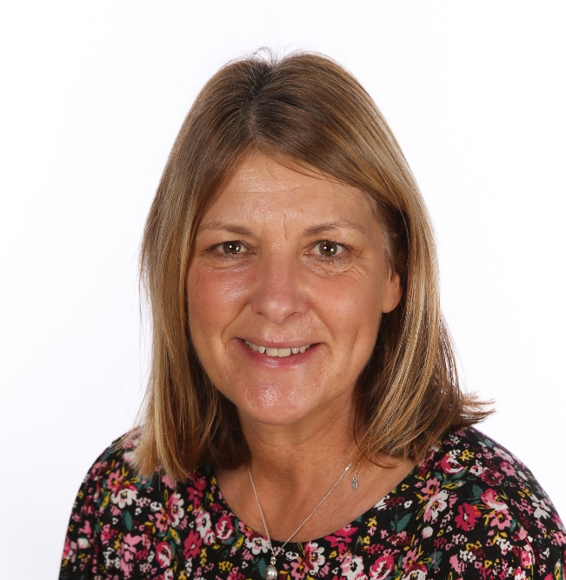
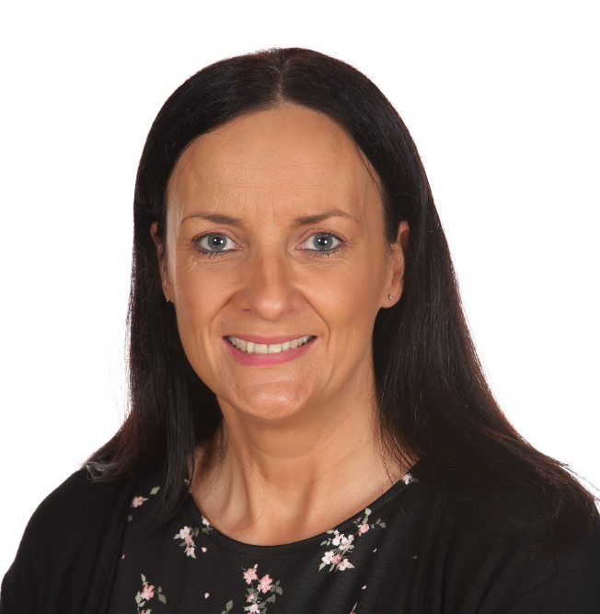

Office Team
SEND Governor
Mrs Crowder
Miss Foster
Miss Moreland
Our SEND Link Governor is responsible for;
Making sure that the necessary support is made for any child who attends the school who has SEND.
Alongside the Head teachers, has responsibility for allocating the SEND budget.
You can contact our SEND Governor, via the school office

Slide 40
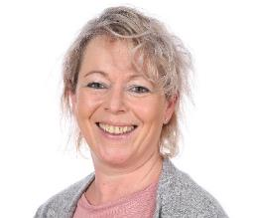

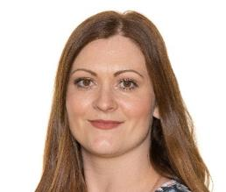


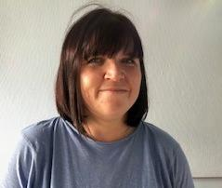
Specialist SEND Team - Nurture
Mrs Parker
Nurture Lead
Mrs Francis
Nurture support
Mrs Shelton
Nurture Support & Emotional Literacy Support Assistant
Mrs Mulligan
Attention Autism and Nurture Support
Miss Deadman
Nurture Support
Mrs Wisher
Nurture Pastroal

Slide 41
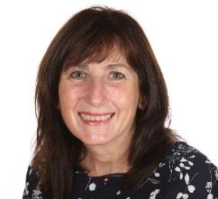
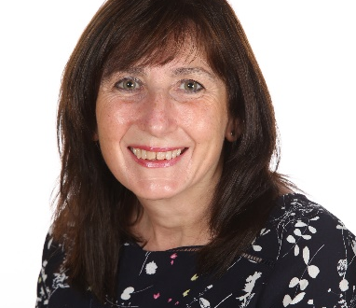



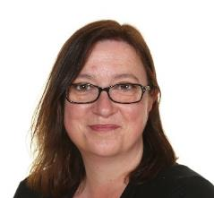
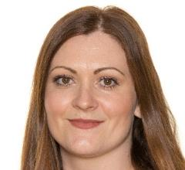
Specialist SEND Team - Interventions
Mrs Harrison
Year One Interventions
Mrs Carmichaeal
Year One & Year Two Interventions
Mrs Askew
Year Two Interventions
Miss Smith
Whole School Interventions (Speech & Language)
Miss Lovell
Whole School Interventions (Positive Play)
Mrs Shelton
Whole School Interventions (ELSA)

Slide 42
Nursery Team
Mrs Lyons
Nursery Teacher
Mrs Hooley
Nursery Teacher & EYFS Lead
Miss Richards
Keyworker
Mrs Sampson-Giles
Keyworker
Mrs Chester
Lunch Club
Miss Spiby
Lunch Club
Mrs Cameron
Lunch Club
Mrs Daniels
Keyworker

Slide 43
Reception Team
Mrs Cross
Teacher
Miss Shepherd
Teacher
Miss Holland
Teacher
Mrs Perks
Teaching Assistant & PPA Cover
Miss Patterson
Teaching Assistant
Mrs Ades
Teacher
Mr Fulwood
PPA Cover
Mrs Swain
Cover TA

Slide 44
Year One Team
Miss Kerwood
Teacher
Mr Stewart
Teacher
Miss Deadman
PPA Cover
Mrs Carmichael
Teaching Assistant
Miss Smith
Teaching Assistant
Mrs Harrison
Teaching Assistant

Slide 45
Year Two Team
Mrs Clampin
Teacher
Mr Jones
Teacher
Mrs Cobley
Teacher
Mr Fulwood
Cover Teaching Assistant
Mrs Swain
Teaching Assistant
Mrs Askew
Teaching Assistant
Miss Warner
Teacher
Mrs Carmichael
Teaching Assistant

Slide 46

ADHD
Attention Deficit Hyperactivity Disorder
AS
Asperger Syndrome
ASD
Autistic Spectrum Disorder
CAMHS
Child and Adolescent Mental Health Service
EHCP
Education, Health and Care Plan
EP
Educational Psychologist
GEP
Group Education Plan
GLD
Global Learning Delay
HI
Hearing Impairment
ILP
Individual Learning Programme
OT
Occupational Therapist
SALT
Speech and Language Therapist
SCODAS
Social Communication Disorders Assessment Service
SENCO
Special Educational Needs Coordinator
SEND
Special Educational Needs and Disabilities
SENDIASS
Special Educational Needs Information and Advice Support Service
SpLD
Specific Learning Difficulty
VI
Visual Impairment
What do all those abbreviations mean?

Slide 47
We would like you to get in touch!
Do you have any questions?
Do you have suggestions about how we can improve our service to you?
Is there a topic you would like to know more about?
Can you recommend places where you take your child with SEND that you have enjoyed, e.g. dentists, opticians, restaurants, play areas, etc.
School Office
0115 9732652
General Enquiries
enquiries@sawley-inf.derbyshire.sch.uk
SENCO
rmorley@sawley-inf.derbyshire.sch.uk
&
rcross@sawley-inf.derbyshire.sch.uk
Website
www.sawleyinfantschool.co.uk

