Slide 1

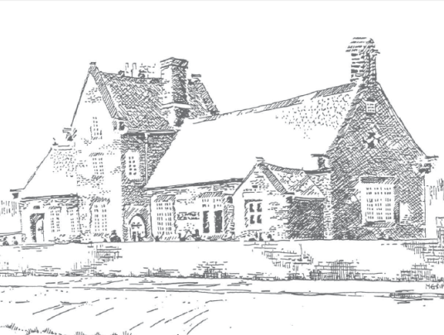


Academy Conversion
Shardlow Sawley Dovedale Sawley
Primary Junior School Primary Infant & Nursery
Consultation
30th April 2014

Slide 2
Special Needs
What is the difference ?
No difference
No difference
Derbyshire School
MAT Academy
What is the same ?
Provision and support will remain the same and be subject to the same legislation.
The LA will continue to coordinate statements of SEN and related funding

Slide 3
Buildings
What is the difference ?
LA specifications apply, all building works require formal approval
Derbyshire School
MAT Academy
What is the same ?
All building work must meet Planning Permission, Building Regulations and Audit requirements

Slide 4

School Name
What is the difference ?
The Multi Academy Trust must have a name – we are proposing Willows Academy Trust
Derbyshire School
MAT Academy
What is the same ?
Each school name will stay the same
Each school will retain it’s own unique identity and ethos

Slide 5

OFSTED
What is the difference ?
Local Authority inspected with reference to supporting all schools
MAT inspected with reference to supporting each school
Derbyshire School
MAT Academy
What is the same ?
Inspection criteria remains the same.
Each school will still be inspected individually

Slide 6
Admissions
What is the difference ?
LA Schools admission criteria
Academy Trust admission criteria
Derbyshire School
MAT Academy
What is the same ?
Apply via Derbyshire admissions
Adhere to School Admissions code
Published admissions policy

Slide 7
Curriculum
What is the difference ?
Implement national curriculum as directed
Create own curriculum to meet DFE requirements
Derbyshire School
MAT Academy
What is the same ?
Each school continues to plan engaging activities to maximise attainment and progress for pupils

Slide 8

Funding
What is the difference ?
LA retains proportion of funding to provide services for all Derbyshire schools
Entire funding used to provide services for to suit MAT schools
Derbyshire School
MAT Academy
What is the same ?
DFE provides funding based on pupil numbers

Slide 9


Nursery Funding
What is the difference ?
No difference
No difference
Derbyshire School
MAT Academy
What is the same ?
15 hours free Early Years/Nursery funding will still be available from the Local Authority

Slide 10
 | School | Same | Academy
Admissions | LA Schools admission criteria | Apply via Derbyshire admissions Adhere to School Admissions code Published admissions policy | Academy Trust admission criteria
School Funding | LA retains proportion of funding to provide services for all Derbyshire schools | DFE provides funding based on pupil numbers | Entire funding used to provide services for to suit MAT schools
Nursery Funding |  | 15 hours free Early Years/Nursery funding will still be available from the Local Authority
Special Needs funding and support |  | Provision and support will remain the same and be subject to the same legislation. The LA will continue to coordinate statements of SEN and related funding
Leave of Absence
Curriculum | Implement national curriculum as directed | Each school continues to plan engaging activities to maximise attainment and progress for pupils | Create own curriculum which meets DFE requirements
OFSTED | Local Authority inspected with reference to supporting all schools | Same Inspection criteria for each school individually | MAT inspected with reference to supporting each school
Buildings | LA approval and specifications apply as Landlords | All building work must meet Planning Permission, Building Regulations and Audit requirements
Term Dates
School Day
School Name |  | Each school name will stay the same | The Multi Academy Trust must have a name – we are proposing Willows Academy Trust

